Slide 1
MULTICONER II
Fine-grained Multilingual
Named Entity Recognition
LOW CONTEXT
Wes
Anderson
Grand
Hotel
B-Artist
I-Artist
B-VisualWork
I-VisualWork
SemEval-2023 Task 2 • Mid-project presentation
33 fine-grained types
12 languages • noisy test data
Team: Vivek, Prakul, Lakshya, Arani, Suyash, Ali
Course: CS-685 NLP
7 October 2026
NER
Notes:
Open by framing MultiCoNER II as NER under three simultaneous pressures: fine-grained labels, little context, and multilingual/noisy inputs. The goal of this mid-project review is to connect the dataset design to the strongest knowledge-augmented systems and then motivate our own experiments.
[Sources]
Fetahu et al. (2023), SemEval-2023 Task 2: https://aclanthology.org/2023.semeval-1.310/

Slide 2
Problem Statement
Fine-grained Multilingual Named Entity Recognition
Fine-grained multilingual NER as token-level sequence labeling
Short text / query
x_1, x_2, …, x_n
Tokenizer + model
(e.g., XLM-R)
BIO label per token
y_1, y_2, …, y_n
Entity spans
+ 33 types
BIO tagging format
Label space
Formal view
B-Type
Beginning of an entity
6 coarse groups
Input: token sequence
Person
Location
Group
X = (x₁, x₂, …, xₙ)
I-Type
Inside same entity span
Creative Work
Product
Medcal
Output: BIO sequence
O
Outside any named entity
Y = (y₁, y₂, …, yₙ)
Expanded into 33 fine-grained classes, e.g., Athlete, Scientist, VisualWork, Vehicle.
Correct answer = exact span + exact fine label
Source: Fetahu et al., 2023; MultiCoNER website
Metric: entity-level macro-F1 per track
MultiCoNER II • Mid-project review
SemEval-2023 Task 2

Slide 3
Problem Statement
Annotated examples
The model must recover both entity boundaries and fine-grained classes
Example 1: Lionel Messi joined Inter Miami
Lionel
Messi
joined
Inter
Miami
Lionel Messi → Athlete
Inter Miami → SportsGRP
B-Athlete
I-Athlete
O
B-SportsGRP
I-SportsGRP
Example 2: Dark was released in 2017
Dark
was
released
in
2017
Dark → VisualWork
Needs real-world knowledge
B-VisualWork
O
O
O
O
Takeaway: partial span matches or wrong fine-grained type are counted as errors.
Examples are illustrative; labels follow MultiCoNER II taxonomy.
MultiCoNER II • Mid-project review
SemEval-2023 Task 2

Slide 4
Problem Statement
Key challenges
Why MultiCoNER II is harder than standard NER
Low context
Fine-grained types
Long-tail entities
Short queries give few clues.
Coarse PERSON is not enough.
Many names are rare or unseen.
“Jordan won again” is ambiguous.
Scientist vs Athlete vs Politician.
Local places, minor artists, niche products.
Multilingual scripts
Noisy test data
External knowledge
12 languages, different tokenization.
Typos and spelling perturbations hurt.
Sentence may not contain the answer.
Bangla, Chinese, Farsi, Hindi, etc.
Noisy subsets reported lower scores.
“Dark” needs TV-series knowledge.
Research question: robust fine-grained entity recognition under low context, multilinguality, noise, and missing knowledge.
Sources: Fetahu et al., 2023 overview and dataset papers; MultiCoNER task site/results.
MultiCoNER II • Mid-project review
SemEval-2023 Task 2

Slide 5
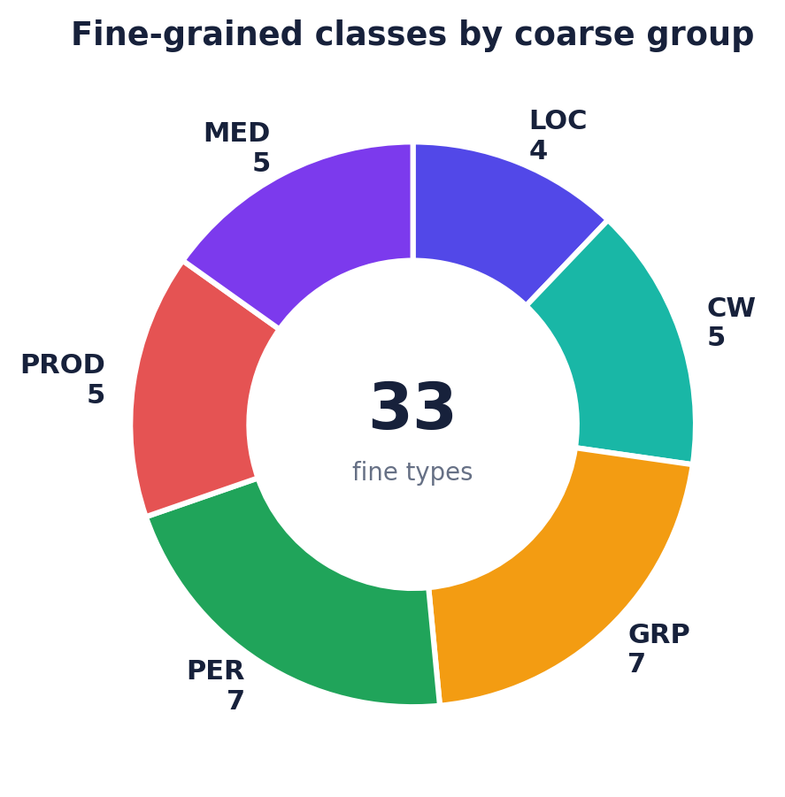
DATASET
Dataset analytics: samples and class taxonomy
MONOLINGUAL SAMPLES
2,171,078
12 languages · train/dev/test
COARSE GROUPS
6
LOC, CW, GRP, PER, PROD, MED
FINE-GRAINED CLASSES
33
BIO labels wrap these classes
SPLIT TOTALS
170,824 / 8,895 / 1,991,359
train / dev / test
LOCATION (4)
Facility · OtherLOC · HumanSettlement · Station
CREATIVE WORK(5)
VisualWork · MusicalWork · WrittenWork · ArtWork · Software
GROUP(7)
MusicalGRP · PublicCORP · PrivateCORP · AerospaceManufacturer · SportsGRP · CarManufacturer · ORG
PERSON(7)
Scientist · Artist · Athlete · Politician · Cleric · SportsManager · OtherPER
PRODUCT (5)
Clothing · Vehicle · Food · Drink · OtherPROD
MEDICAL(5)
Medication/Vaccine · MedicalProcedure · AnatomicalStructure · Symptom · Disease
Class pie uses the official taxonomy: share = number of fine-grained entity types under each coarse group.
Source: MultiCoNER task dataset page and Fetahu et al. (2023). Sample total excludes the derived MULTI track to avoid double counting.
MULTICONER II · Mid-project review
SemEval 2023 Task 2

Slide 6
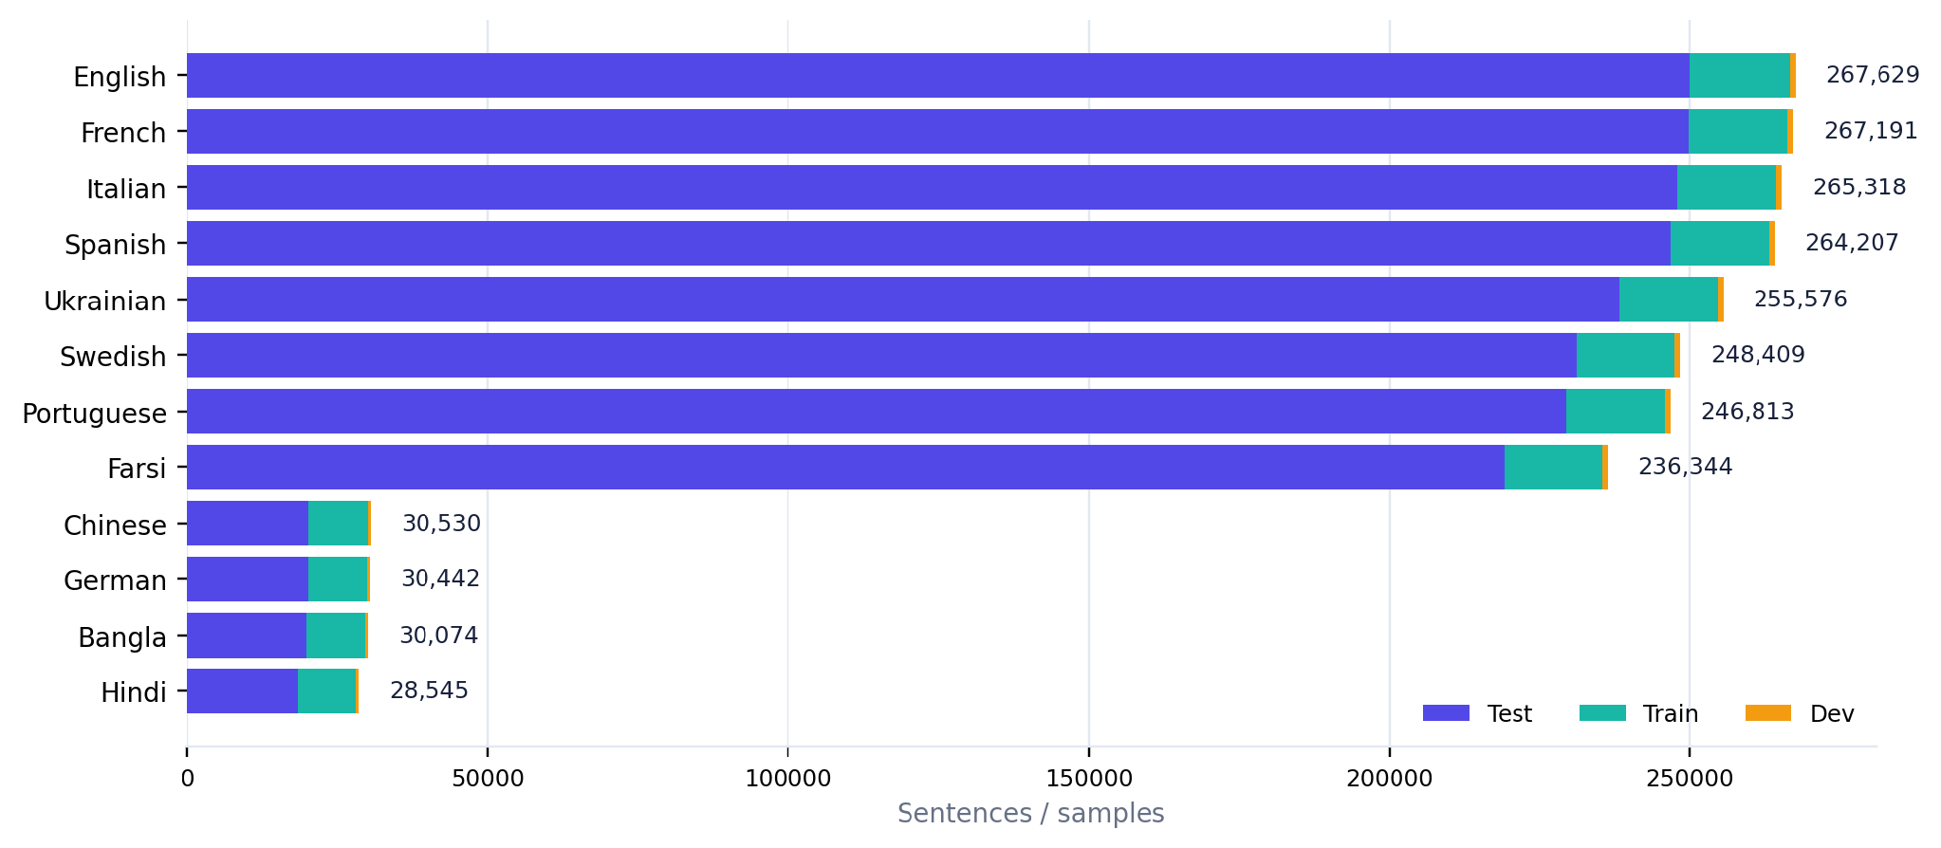
DATASET
Dataset analytics: distribution across languages
LARGEST LANGUAGES
EN / FR / IT / ES
≈265K–268K samples each
LOW-RESOURCE SET
BN / HI / DE / ZH
≈28K–31K samples each
TOTAL TEST SHARE
91.7%
large hidden test phase
LANGUAGES
12
plus separate MULTI track
Exact totals
EN
267.6K
PT
246.8K
FR
267.2K
FA
236.3K
IT
265.3K
ZH
30.5K
ES
264.2K
DE
30.4K
UK
255.6K
BN
30.1K
SV
248.4K
HI
28.5K
Interpretation: English/French/Italian/Spanish dominate sample count; Bangla/Hindi/German/Chinese are much smaller, making multilingual transfer important.
Source: official MultiCoNER v2 train/dev/test counts reported by Fetahu et al. (2023); values are sentence/sample counts.
MULTICONER II · Mid-project review
SemEval 2023 Task 2

Slide 7
SELECTED BIBLIOGRAPHY
Research Papers
11. Fetahu et al. (2022). Dynamic Gazetteer Integration in Multilingual Models for Cross-Lingual and Cross-Domain NER. NAACL 2022.
12. Conneau et al. (2020). Unsupervised Cross-lingual Representation Learning at Scale. ACL 2020.
13. Ri et al. (2022). mLUKE: The Power of Entity Representations in Multilingual Pretrained Language Models. ACL 2022.
14. Lewis et al. (2020). Retrieval-Augmented Generation for Knowledge-Intensive NLP Tasks. NeurIPS 2020.
15. Yu et al. (2020). Named Entity Recognition as Dependency Parsing. ACL 2020.
16. Li et al. (2020). A Unified MRC Framework for Named Entity Recognition. ACL 2020.
17. Wang et al. (2023). GPT-NER: Named Entity Recognition via Large Language Models. arXiv:2304.10428. (Later Findings NAACL 2025.)
18. Zhou et al. (2024). UniversalNER: Targeted Distillation from Large Language Models for Open NER. ICLR 2024.
19. Ashok & Lipton (2023). PromptNER: Prompting For Named Entity Recognition. arXiv:2305.15444.
20. Zhou et al. (2022). MELM: Data Augmentation with Masked Entity Language Modeling for Low-Resource NER. ACL 2022.
1. Fetahu et al. (2023). SemEval-2023 Task 2: Fine-grained Multilingual NER (MultiCoNER 2). SemEval-2023.
2. Fetahu et al. (2023). MultiCoNER v2: a Large Multilingual Dataset for Fine-grained and Noisy NER. Findings EMNLP 2023.
3. Malmasi et al. (2022). SemEval-2022 Task 11: Multilingual Complex NER (MultiCoNER). SemEval-2022.
4. Malmasi et al. (2022). MultiCoNER: A Large-scale Multilingual Dataset for Complex NER. COLING 2022.
5. Tan et al. (2023). DAMO-NLP at SemEval-2023 Task 2: A Unified Retrieval-augmented System for Multilingual NER. SemEval-2023.
6. Ma et al. (2023). PAI at SemEval-2023 Task 2: A Universal System for NER with External Entity Information. SemEval-2023.
7. Wang et al. (2022). DAMO-NLP at SemEval-2022 Task 11: A Knowledge-based System for Multilingual NER. SemEval-2022.
8. Wang et al. (2021). Improving NER by External Context Retrieving and Cooperative Learning. ACL-IJCNLP 2021.
9. Chen et al. (2022). USTC-NELSLIP at SemEval-2022 Task 11: Gazetteer-Adapted Integration Network. SemEval-2022.
10. Meng et al. (2021). GEMNET: Effective Gated Gazetteer Representations for Recognizing Complex Entities in Low-context Input. NAACL 2021.
Notes:
The slide lists all twenty reviewed papers in compact form. The accompanying verification appendix in the markdown deliverable gives the exact metadata corrections and clarifies preprint-versus-conference status where relevant. For the presentation itself, emphasize only the closest works and point the audience to the written bibliography for the full details.
[Sources]
ACL Anthology and arXiv pages verified during preparation.

Slide 8
20-PAPER MAP
Literature review: task lineage + knowledge augmentation
Group | Papers | Representative work | What it contributes
A • Task/data | 1–4 | MultiCoNER II + v1 | Defines benchmark, taxonomy, noise, low-context setting
B • Knowledge | 5–11 | DAMO, PAI, GAIN, GEMNET | Retrieval/gazetteers consistently close context gaps
C • Methods | 12–16 | XLM-R, mLUKE, RAG, span/MRC | Backbones and alternative extraction formulations
D • LLM/low-resource | 17–20 | GPT-NER, UniversalNER, PromptNER, MELM | Generation, distillation, prompting, augmentation
Pattern across the literature
Low context → add knowledge. Noise → augment/correct. Fine labels → stronger representations or span formulations.
Verified against ACL Anthology/arXiv; full bibliography on Slide 14 and verification appendix.
Notes:
The twenty papers fall into four coherent families rather than twenty isolated citations. The task/dataset papers define the challenge; top shared-task systems show that external knowledge is the dominant practical strategy. Foundational papers explain why multilingual representations, entity representations, retrieval, and span extraction are relevant. The last group provides alternatives for low-resource and LLM-era NER, but does not yet remove the need for careful extraction-oriented modeling.
[Sources]
ACL Anthology entries listed in Slide 14
arXiv: 2304.10428, 2305.15444
ICLR 2024 UniversalNER

Slide 9
DEEP DIVE
Closest work 1: MultiCoNER II overview + dataset
Problem
Fine-grained multilingual NER under low context and noise.
Open resources
Type mapping
Train / dev
Noisy test
Dataset innovation
33 types, 12 languages, explicit corruption benchmark.
Strength
Realistic long-tail + noise stress test.
Baseline signal
Gap for us
Baseline leaves large room for robust knowledge use.
XLM-R baseline macro-F1 ≈ 0.63 across languages.
Sources: Fetahu et al., SemEval 2023; Fetahu et al., Findings EMNLP 2023.
Notes:
These two papers define the target problem rather than proposing the winning architecture. Their strongest contribution for our project is the controlled benchmark design: fine-grained labels plus explicit noise. The dataset paper reports an XLM-R macro-F1 around 0.63 across languages and shows that entity corruption is particularly damaging. This makes a plain multilingual encoder a principled baseline, but not an adequate endpoint.
[Sources]
https://aclanthology.org/2023.semeval-1.310/
https://aclanthology.org/2023.findings-emnlp.134/

Slide 10
DEEP DIVE
Closest work 2: DAMO-NLP U-RaNER
9 / 13 tracks won
Input
Multi-search
Wikidata KB
Knowledge infusion
PLM + NER
Ensemble
Why it works
Strength
Limitations
Entity-centric Wikidata knowledge; multiple retrieval strategies; longer effective knowledge context.
Best overall shared-task system; public U-RaNER implementation in AdaSeq.
Retrieval/indexing cost; pipeline complexity; ensemble compute; retrieval errors can propagate.
Relative gap: can we retain most of the gain with a lighter, noise-aware pipeline?
Source: Tan et al., SemEval 2023 (U-RaNER); official leaderboard.
Notes:
U-RaNER is the strongest direct reference because it won nine of the thirteen tracks. Its central diagnosis is that previous systems were bottlenecked by insufficient or poorly visible external knowledge. It therefore combines Wikidata-centered retrieval, multiple search strategies, knowledge-quality refinement, and an infusion mechanism that expands useful context before NER. The price is a relatively heavy retrieval and ensembling pipeline, which motivates our efficiency-focused gap.
[Sources]
https://aclanthology.org/2023.semeval-1.277/
https://multiconer.github.io/results

Slide 11
DEEP DIVE
Closest work 3: PAI — simple external entity information
2× 1st • 4× 2nd • 1× 3rd
Input sentence
Wikipedia retrieval
Entity + properties
Concatenate
Transformer NER
Reproducible idea
Strength
Limitations
Retrieve candidate entities/properties and append them to the input.
Conceptually simpler than U-RaNER; public implementation.
Concatenation can exceed context budget; retrieval noise directly enters encoder.
Useful baseline for our ablation: no retrieval vs. simple retrieval vs. filtered retrieval.
Source: Ma et al., SemEval 2023.
Notes:
PAI is valuable because the core mechanism is easy to explain and reproduce. It retrieves entity information from Wikipedia, concatenates it with the sentence, and feeds the augmented input into Transformer-based NER models. Despite that simplicity, the team achieved two first places, four second places, and one third place. For our project, this is an excellent intermediate baseline between plain XLM-R and a more engineered U-RaNER-style retriever.
[Sources]
https://aclanthology.org/2023.semeval-1.102/

Slide 12
DEEP DIVE
Closest work 4: GEMNET + dynamic gazetteers
Earlier knowledge integration: match known entities, then learn when to trust them.
GEMNET
Context encoder
Up to +49% F1 on difficult uncased settings.
Learned gate
/ MoE
Token labels
Gazetteer encoder
Dynamic gazetteer
+17.6 F1 cross-lingual; +21.3 F1 cross-domain.
Limitation: coverage and staleness of gazetteer entries; exact-string matching under noise.
Sources: Meng et al., NAACL 2021; Fetahu et al., NAACL 2022.
Notes:
GEMNET predates MultiCoNER II but attacks the same low-context problem with gazetteer information. Its key idea is not to trust the gazetteer blindly: a gating mechanism learns when contextual representations versus gazetteer features are more reliable. The later dynamic gazetteer work applies token-level gating in multilingual and cross-domain transfer and reports large gains over baselines. A weakness for noisy NER is that gazetteer matching itself may fail when the entity surface form is corrupted.
[Sources]
https://aclanthology.org/2021.naacl-main.118/
https://aclanthology.org/2022.naacl-main.200/

Slide 13
MULTICONER II • MID-PROJECT REVIEW
Thank You
Questions and feedback are welcome.
Fine-grained multilingual NER
MultiCoNER II • Mid-project review
15

